Slide 1
Foundations of Data Science & Analytics (DSCI 633, Fall 2022)
Nidhi Rastogi
Assistant Professor, GCCIS
Rochester Institute of Technology
August 25, 2022

Slide 2
Instructor Introduction
Ph.D. in Computer Science, Rensselaer Polytechnic Institute
M.S. in Computer Science, University of Cincinnati
Bachelors in Information Technology , Delhi University, India
Worked at GE Global Research, Verizon in Engineering & Research positions
Interned at Yahoo, IBM Zurich, BBN Raytheon, GE Global Research
Research Interests - Machine learning, Graphs, Security, Autonomous Vehicles, Large distributed networks…

Slide 3

TA Introduction
Addl Tariq
MS Data Science, 2nd Year
TA Hours, email on class GitHub webpage
Also available outside of office hours
Only by appointment – contact on slack or email

Slide 4
Course Information
GitHub link - https://github.com/aiforsec/RIT-DSCI-633-FDS

Slide 5

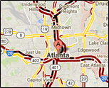
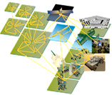



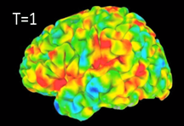
Data Mining is Everywhere
Cybersecurity
Traffic Patterns
Analyzing Sensor Data
E-Commerce
Social Networks
Brain Activity

Slide 6
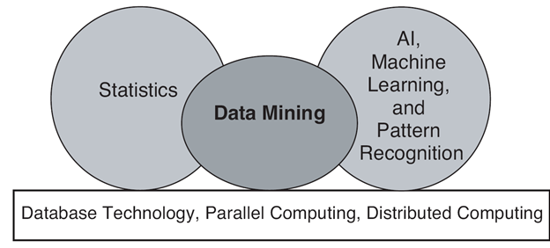
Origin of Data Mining
Especially for data:
Large-scale
High dimensional
Complex
Distributed

Slide 7


Why the Trend (Why now?)
Lot of data is being collected and warehoused
Amazon handles millions of visits/day
Google has Peta Bytes of web data
Facebook has billions of monthly active users
Computation has become cheaper & more powerful

Slide 8
Data Mining
What is
Certain names are more prevalent in certain US locations (O’Brien, O’Rourke, O’Reilly… in Boston area)
Predict whether user want information on Amazon rainforest or Amazon.com when searching for “Amazon”
What is NOT
Look up phone number in phone directory
Query a Web search engine for information about “Amazon”

Slide 9
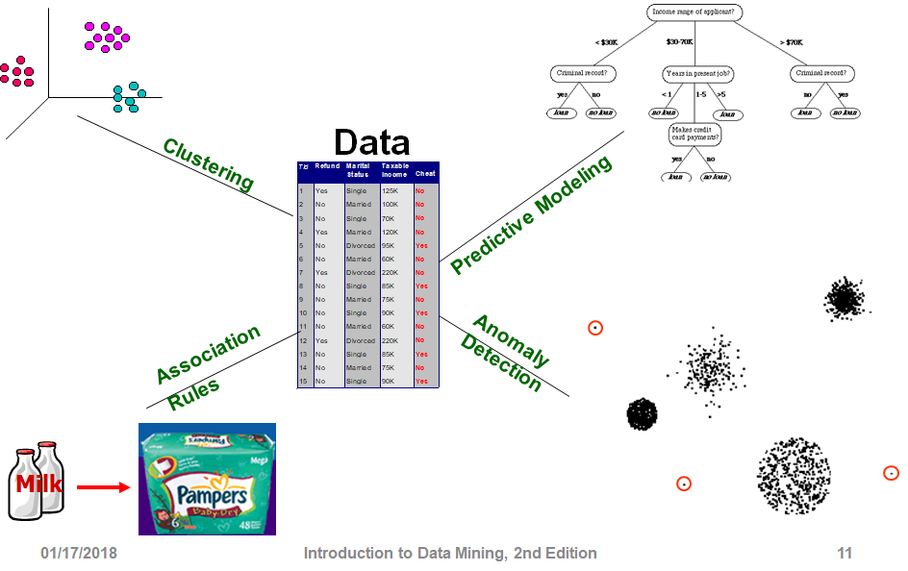
Tasks
Notes:
predict future events or outcomes by analyzing patterns in a given set of input data

Slide 10

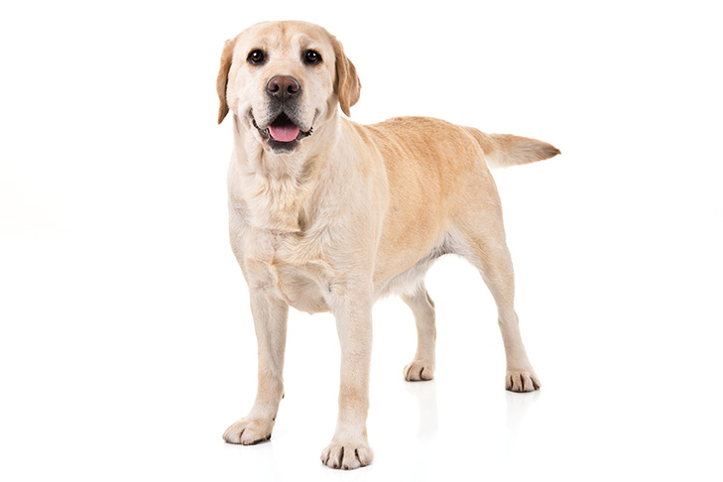

Predictive Modeling (supervised learning)
Independent Variable (Input)
Dependent Variable (Output)
Cat
Train:
Dog
Predict:
?

Slide 11
Predictive Modeling
Output
Classification:
Regression:
Classes / Categories
Continuous Numbers

Slide 12
Predictive Modeling: Classification
Image Classification
Cat
Dog
Bird
Pig
Lion
...

Slide 13
Predictive Modeling: Classification
Sentiment Analysis (NLP)
You have been working on this for months.
I need to see your results, now!
Positive
Neutral
Negative

Slide 14
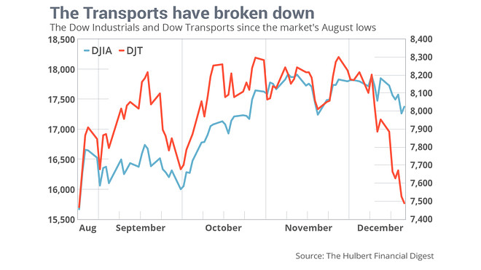
Predictive Modeling: Regression
Time Series Analysis
Dow Jones Industrial Average (DJIA)
and Dow Jones Transportation Average (DJT) for January?

Slide 15
Predictive Modeling: Regression
ID | Name | Gender | GRE | Coding
001 | Emily Wang | F | 320 | Yes
002 | James Bond | M | 320 | Yes
Problem?
Bias
Score in Foundation of Data Science

Slide 16
Tasks

Slide 17
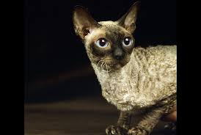


Clustering (unsupervised learning)
Independent Variable

Slide 18
Clustering (unsupervised learning)
Independent Variable

Slide 19
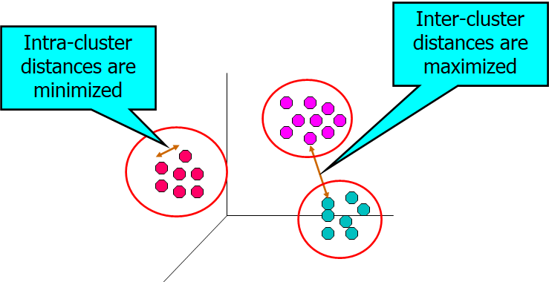
Clustering (objectives)

Slide 20
Clustering (applications)
User ID | Titanic | Die Hard | Avatar
001 | Yes | Yes | No
002 | Yes | No | Yes
Groups of users that like similar movies

Slide 21
Clustering (applications)
Topic Modeling
Area soccer players earn all-state selections.
Sports | Politics | News | Movie
0.4 | 0.18 | 0.4 | 0.02

Slide 22
Tasks

Slide 23
Association Rule Learning
User ID | Titanic | Die Hard | Avatar
001 | Yes | Yes | Yes
002 | Yes | No | Yes
People who watched Titanic will also watch Avatar

Slide 24
Tasks

Slide 25
Anomaly Detection
Purchase | 11/03/2019 | 11/13/2019 | 11/23/2019 | 12/03/2019 | 12/04/2019
001 | Titanic | Avatar | Die Hard | Aliens | Hunter X Hunter

Slide 26
Use Case
Software Defect Prediction

Slide 27
Task: Given a piece of code, predict whether it has defects or not.
Binary Classification
int minval(int *A, int n) {
int currmin;
for (int i=0; i<n; i++)
if (A[i] < currmin)
currmin = A[i];
return currmin;
}
Model
Bug?

Slide 28
Data Availability
Supervised Learning
10 different software projects
Each has 5 releases
Each release has around 100 code modules
All code modules are labeled as buggy or non-buggy
Around 20% code modules have bugs

Slide 29
Task Specification
Within-project prediction
For project i, given past releases as training data, predict code modules in current release.
Cross-project prediction
For project i, given other projects as training data, predict defect code modules in project i.

Slide 30
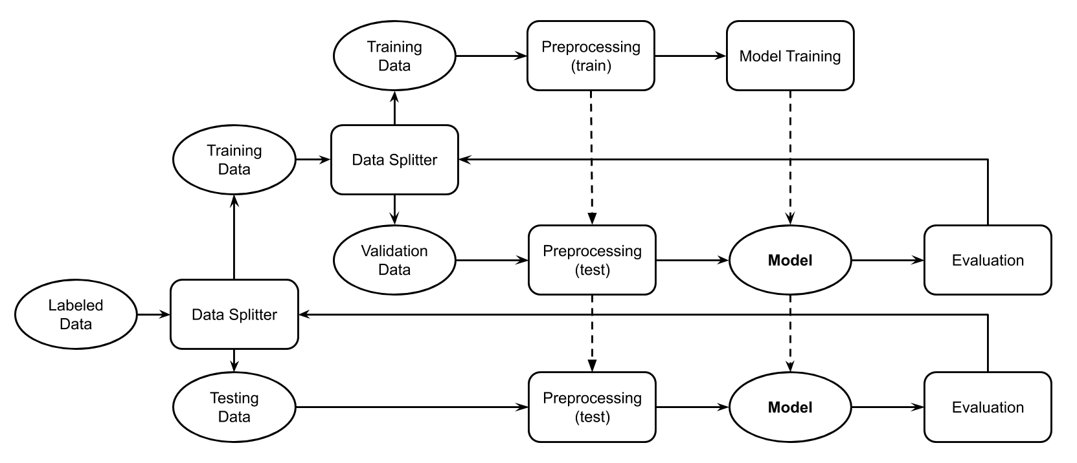
Within-Project Prediction
Release j < i
Release 1 to m-1
Release i
Release
m

Slide 31
Cross-Project Prediction
Other Projects
Other Projects
Project i
Project k

Slide 32
Evaluation
Precision
Recall
F1
AUC
For the buggy class!!!

Slide 33
Preprocessing
Very domain-specific
Best way to start:
Understand baseline approaches
Review existing models (github, Kaggle, …)
check how other researchers featurize the code modules

Slide 34
Preprocessing
Software metrics:
E.g. lines of code, number of inputs
Only has abstract information
Can use tools to extract
Low dimensionality (10 - 20)
Text mining features:
Treat codes as natural language
High dimensionality (thousands to millions)

Slide 35
Software Metrics
Normalize on columns
name | loc | wmc | dit | noc | cbo | rfc | lcom
org.apache.lucene.analysis.WhitespaceAnalyzer | 10 | 2 | 2 | 0 | 3 | 4 | 1
org.apache.lucene.search.QueryTermVector | 278 | 10 | 1 | 0 | 4 | 37 | 0
org.apache.lucene.analysis.PorterStemmer | 1174 | 27 | 1 | 0 | 1 | 43 | 13

Slide 36
Text Mining Features
Normalize on rows
int minval(int *A, int n) {
int currmin;
for (int i=0; i<n; i++)
if (A[i] < currmin)
currmin = A[i];
return currmin;
}
int minval int a int n int currmin for int i 0 i n i if a i currmin currmin a i return currmin
Term Frequency
Tokenize
int | minval | a | n | currmin | for | i | 0 | if | return
5 | 1 | 3 | 1 | 4 | 1 | 5 | 1 | 1 | 1

Slide 37
Preprocessing
Data Balancing:
Target is minority
Data Balancing is critical
Dimensionality Reduction?
Principal Component Analysis (PCA)
Linear Discriminant Analysis (LDA)

Slide 38
Model
Naive Bayes
SVM
Random Forest
Decision Tree

Slide 39
Model / Parameter Selection
Tuning:
Evolutionary algorithms (GA, SA, DE, ...)
Grid search / Random search
Surrogate models (Bayesian Optimization)

Slide 40
Testing
Collect performance metrics on test data
Discuss with customer to check whether the results satisfy the requirements
Make improvements based on customer feedback

Slide 41
Preparation for HomeWorks and Project
Create GitHub account
Star : https://github.com/aiforsec/RIT-DSCI-633-FDS
4. Slack Channel for the course

Slide 42
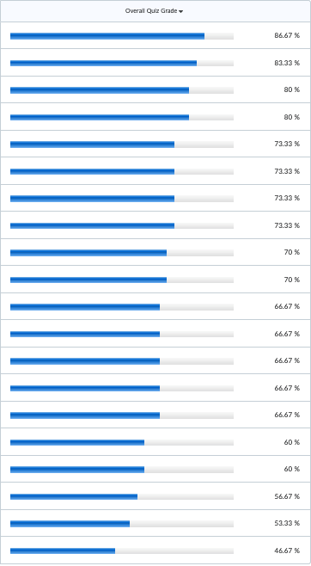
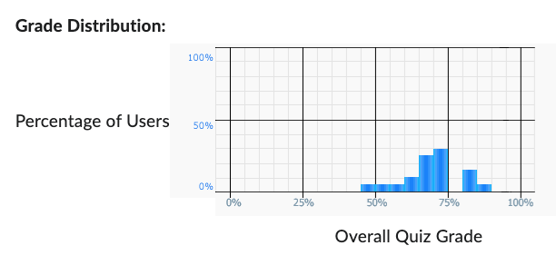
Python Quiz – Class Performance
Class Average: 68.67%

Slide 43
Questions

